Slide 1
PROJECT UNIT 1-2
Students
Lorena Alejandro
Silvia Vacacela
Teacher
Marlon Armijos
2016

Slide 2
WATER POLLUTION

Slide 3
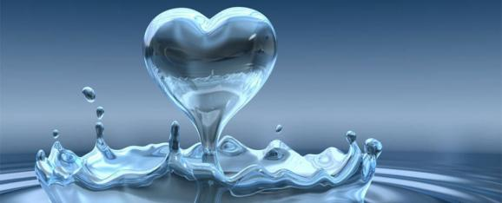
A Country with problems of wAter is the beat of a heart that struggle to SURVIVE

Slide 4

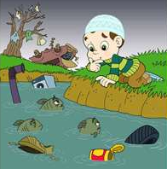
The fresh water is the renovable recourse the most important for live
but the humans are using and contaminating faster of the need for restore.

Slide 5
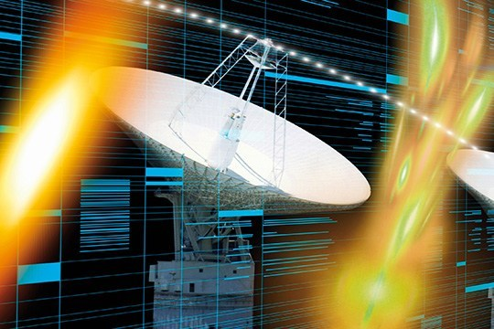
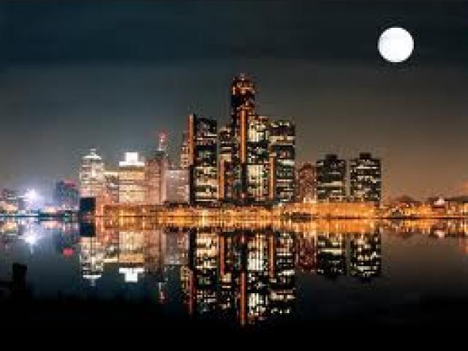
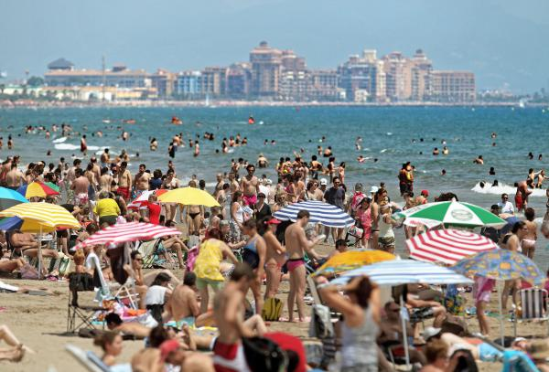
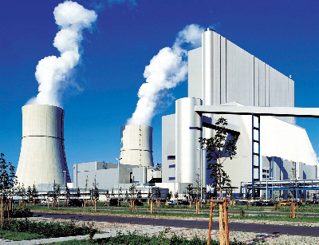
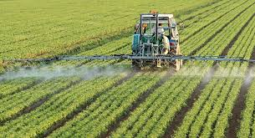

Slide 6
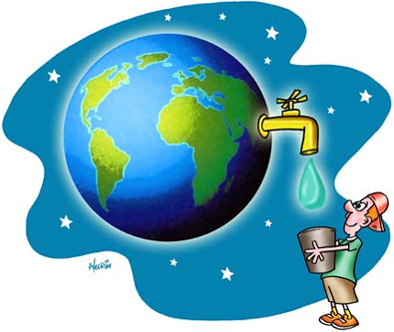
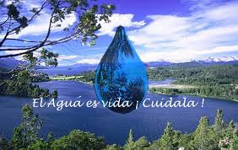
make this small percentage go naturally and reducing its composition see significantly altered.

Slide 7
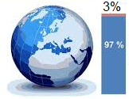
The total water on the planet, only 3% is fresh water

Slide 8
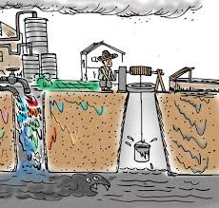
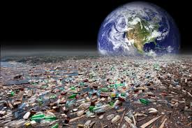

Slide 9
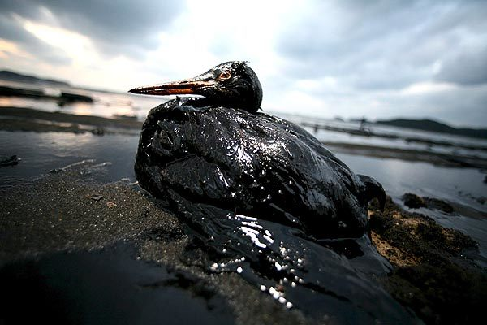
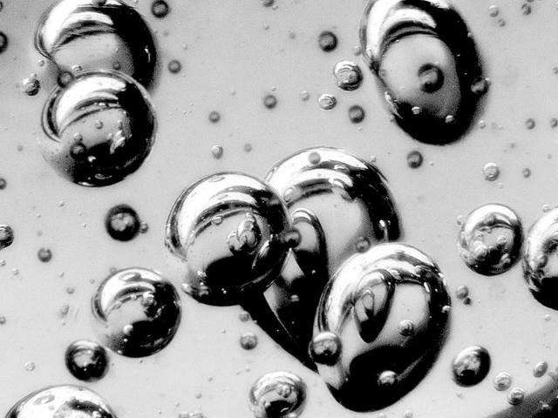
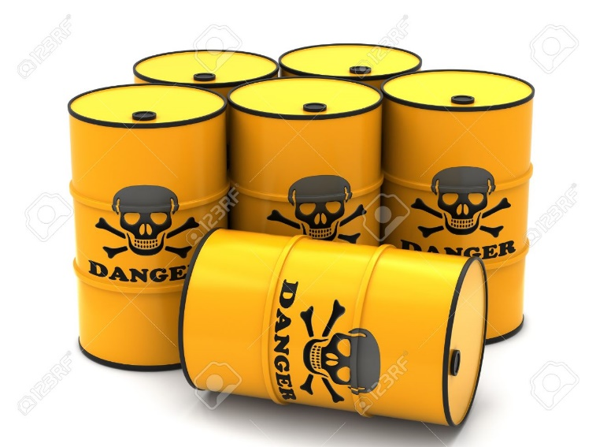
It is pollution originates from various factors such as:

Slide 10
